Slide 1
DBMS COURSE PROJECT
Design and Implementation of a Database Management System for
Online Course Learning Progress Management System
Team Members
Final Presentation
Academic Year 2025–2026
B.Tech, School of Technology
Saanvi Eluri – 25WU0101114
R.Bhavya Sree –25WU0101108
Kushal Karthikeya – 25WU0101055

Slide 2
Problem Description
Online platforms must track content, enrolments, progress, quizzes and certificates. Without a structured database, learner progress is unreliable and reporting is manual.
Objectives
Scope
Intended Users
Model course → module → lesson
Track enrolment and progress
Record quiz attempts and scores
Issue certificates
13 tables, normalized to 3NF
MySQL with PK, FK, CHECK
Python UI: insert, delete, view
Reports and views
Admin: manages data
Instructors: publish courses, view summaries
Learners: enrol, learn, take quizzes
Online Course Learning Progress Management System
2

Slide 3
ER Diagram
Instructor
Course
Module
Lesson
1:N
1:N
1:N
1:N
1:N
1:N
Learner
Enrolment
LessonProgress
Quiz
1:N
1:N
1:N
1:1
1:N
1:N
1:N
Feedback
Certificate
Attempt
Question
1:N
1:N
Teal = transaction entities (learner activity)
Light = master entities (content and people)
Response
Online Course Learning Progress Management System
3

Slide 4
Relationships, Cardinality and Rules
Relationship | Cardinality | Participation
Instructor teaches Course | 1 : N | Course total
Course contains Module / Lesson | 1 : N | Total
Learner enrols in Course | M : N via Enrolment | Enrolment total
Enrolment has Lesson Progress | 1 : N | Partial
Quiz has Question; Attempt has Response | 1 : N | Total
Enrolment earns Certificate | 1 : 1 | Partial
Enrolment receives Feedback | 1 : N | Partial
Business Rules
One enrolment per learner per course
Progress between 0 and 100
Quiz attempts limited per quiz
Score never exceeds max score
Certificate only after completion
Online Course Learning Progress Management System
4

Slide 5
Relational Schema and 3NF
instructor instructor_id PK, name, email, department
learner learner_id PK, name, email, joined_date
course course_id PK, title, level, instructor_id FK
module module_id PK, course_id FK, title, seq_no
lesson lesson_id PK, module_id FK, title, duration_min
enrolment enrolment_id PK, learner_id FK, course_id FK, status, enrolled_on
lesson_progress progress_id PK, enrolment_id FK, lesson_id FK, completion_pct
quiz quiz_id PK, course_id FK, title, max_score, max_attempts
question question_id PK, quiz_id FK, question_text, correct_option, marks
attempt attempt_id PK, enrolment_id FK, quiz_id FK, attempt_no, score
response response_id PK, attempt_id FK, question_id FK, chosen_option
certificate certificate_id PK, enrolment_id FK, issue_date
feedback feedback_id PK, enrolment_id FK, rating, comments
1NF
Atomic values, every table has a primary key
2NF
No partial dependency on composite keys
3NF
No transitive dependency; instructor data lives only in instructor
Online Course Learning Progress Management System
5

Slide 6
Database and Table Creation
CREATE TABLE enrolment (
enrolment_id INT AUTO_INCREMENT PRIMARY KEY,
learner_id INT NOT NULL,
course_id INT NOT NULL,
status VARCHAR(12) NOT NULL DEFAULT 'Active',
enrolled_on DATETIME DEFAULT CURRENT_TIMESTAMP,
UNIQUE (learner_id, course_id),
CHECK (status IN ('Active','Completed','Dropped')),
FOREIGN KEY (learner_id) REFERENCES learner(learner_id),
FOREIGN KEY (course_id) REFERENCES course(course_id)
);
CREATE TABLE lesson_progress (
progress_id INT AUTO_INCREMENT PRIMARY KEY,
enrolment_id INT NOT NULL,
lesson_id INT NOT NULL,
completion_pct INT NOT NULL DEFAULT 0,
UNIQUE (enrolment_id, lesson_id),
CHECK (completion_pct BETWEEN 0 AND 100),
FOREIGN KEY (enrolment_id) REFERENCES enrolment
(enrolment_id) ON DELETE CASCADE
);
PRIMARY / FOREIGN KEY
Links all 13 tables
UNIQUE
One enrolment per course
CHECK
Progress 0–100, rating 1–5
NOT NULL / DEFAULT
Status, dates, progress
INDEX
On email and course_id
Sample data
At least 5 rows per table
Online Course Learning Progress Management System
6

Slide 7
SQL Queries
Query 1 - Join + aggregate: learner progress
Output of Query 1
SELECT l.name AS learner, c.title AS course,
ROUND(AVG(lp.completion_pct),1) AS progress
FROM learner l
JOIN enrolment e ON e.learner_id = l.learner_id
JOIN course c ON c.course_id = e.course_id
JOIN lesson_progress lp
ON lp.enrolment_id = e.enrolment_id
GROUP BY l.name, c.title;
Learner | Course | Progress
Anita Sharma | Data Science Introduction | 40.0
Anita Sharma | Python Basics | 100.0
Arjun Patel | Java Object-Oriented Programming | 100.0
Karan Singh | Python Basics | 100.0
Karan Singh | Web Design Fundamentals | 100.0
Meera Iyer | Data Science Introduction | 100.0
Priya Reddy | Python Basics | 35.0
Rahul Verma | Python Basics | 62.5
Rahul Verma | Web Design Fundamentals | 100.0
Query 2 - Aggregate: learners per course
SELECT c.title, COUNT(e.enrolment_id) AS learners
FROM course c LEFT JOIN enrolment e
ON e.course_id = c.course_id
GROUP BY c.title;
Query 3 - Nested: learners who scored 5+ out of 10
SELECT name FROM learner WHERE learner_id IN (
SELECT learner_id FROM enrolment WHERE
enrolment_id IN (SELECT enrolment_id
FROM attempt WHERE score >= 5));
Query 2: Python Basics 4, Web Design 2, Data Science 2, Java 1, Statistics 0
Query 3: Anita, Arjun, Karan, Meera, Rahul
Online Course Learning Progress Management System
7

Slide 8
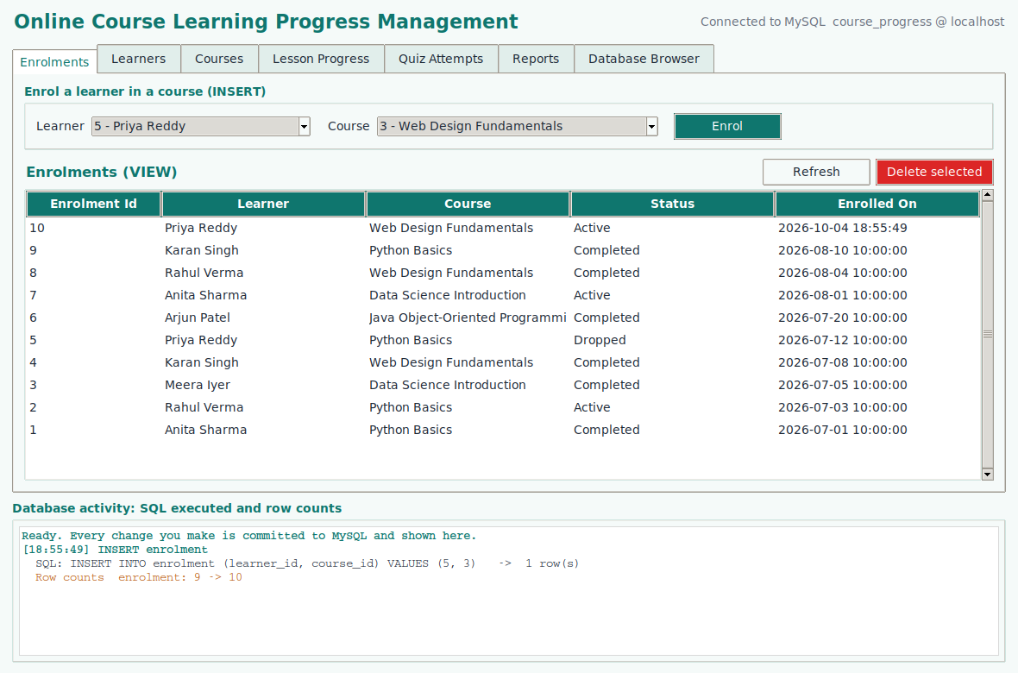
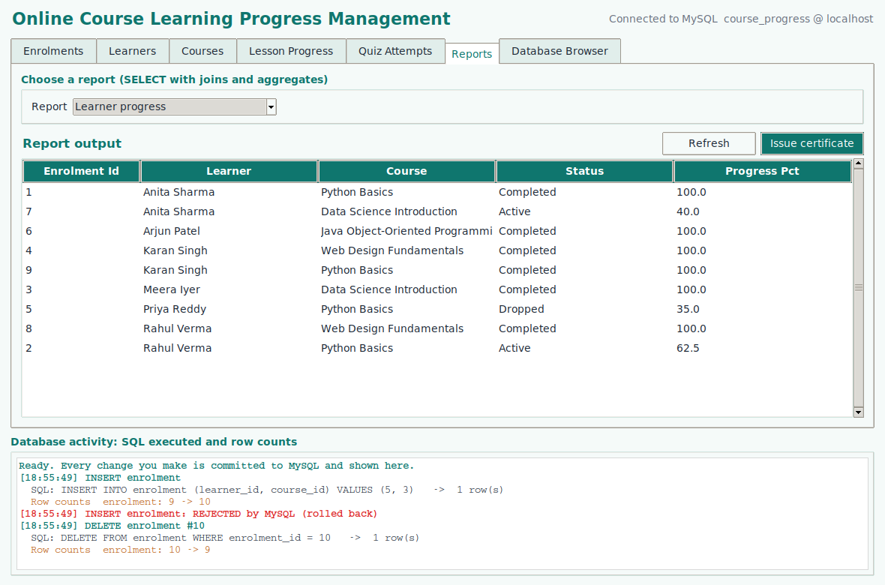
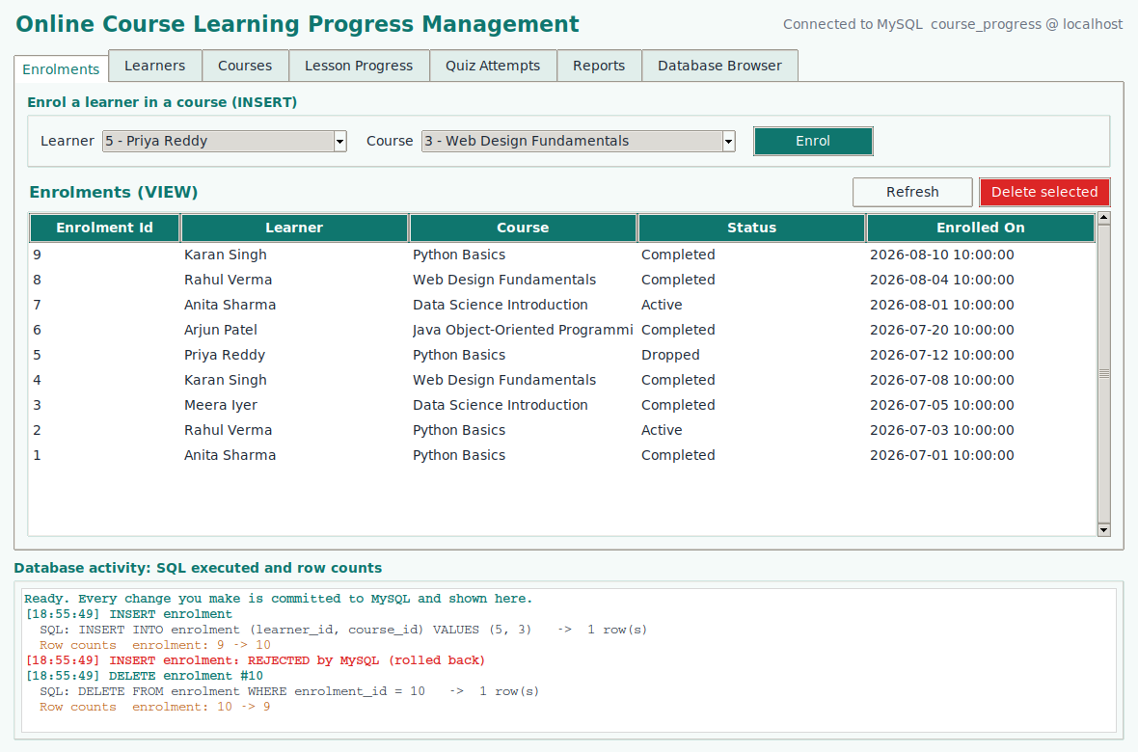
User Interface Demo
Insert
View
Delete
Enrol Priya Reddy in Web Design: enrolment 9 to 10
Learner progress report from joins
Remove the enrolment: enrolment 10 to 9
Every action shows the SQL executed and the row counts in the activity panel, and is checked in MySQL.
Python UI (Tkinter)
→
MySQL Connector
→
MySQL Database
Online Course Learning Progress Management System
8

Slide 9
Testing and Validation
Test case | Expected result | Result
Duplicate enrolment | Rejected by UNIQUE key (error 1062) | Pass
Progress set to 120 | Rejected by CHECK constraint | Pass
Delete a course or learner in use | Blocked by foreign key (error 1451) | Pass
Quiz attempts beyond limit | Blocked by app validation | Pass
Insert, view, delete in UI | Reflected in database | Pass
Conclusion: a normalized, constraint-driven database gives reliable progress tracking and reporting.
Future: web portal, video progress, auto-graded quizzes.
Online Course Learning Progress Management System
9

